Slide 1


Slide 2


Slide 3


Slide 4
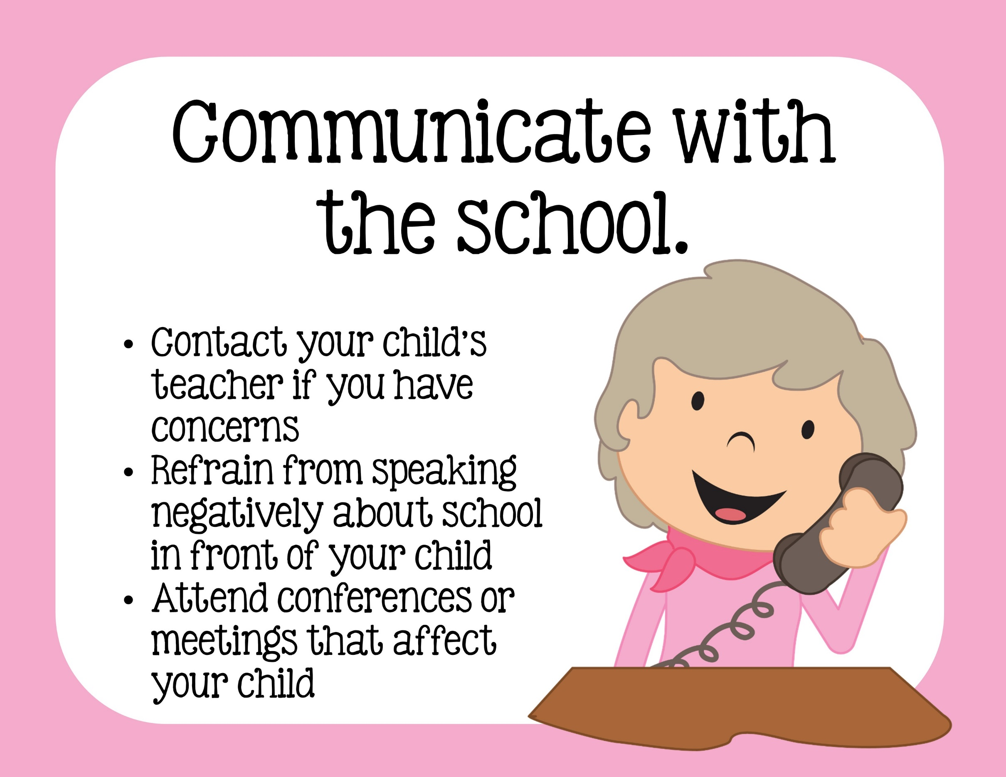

Slide 5
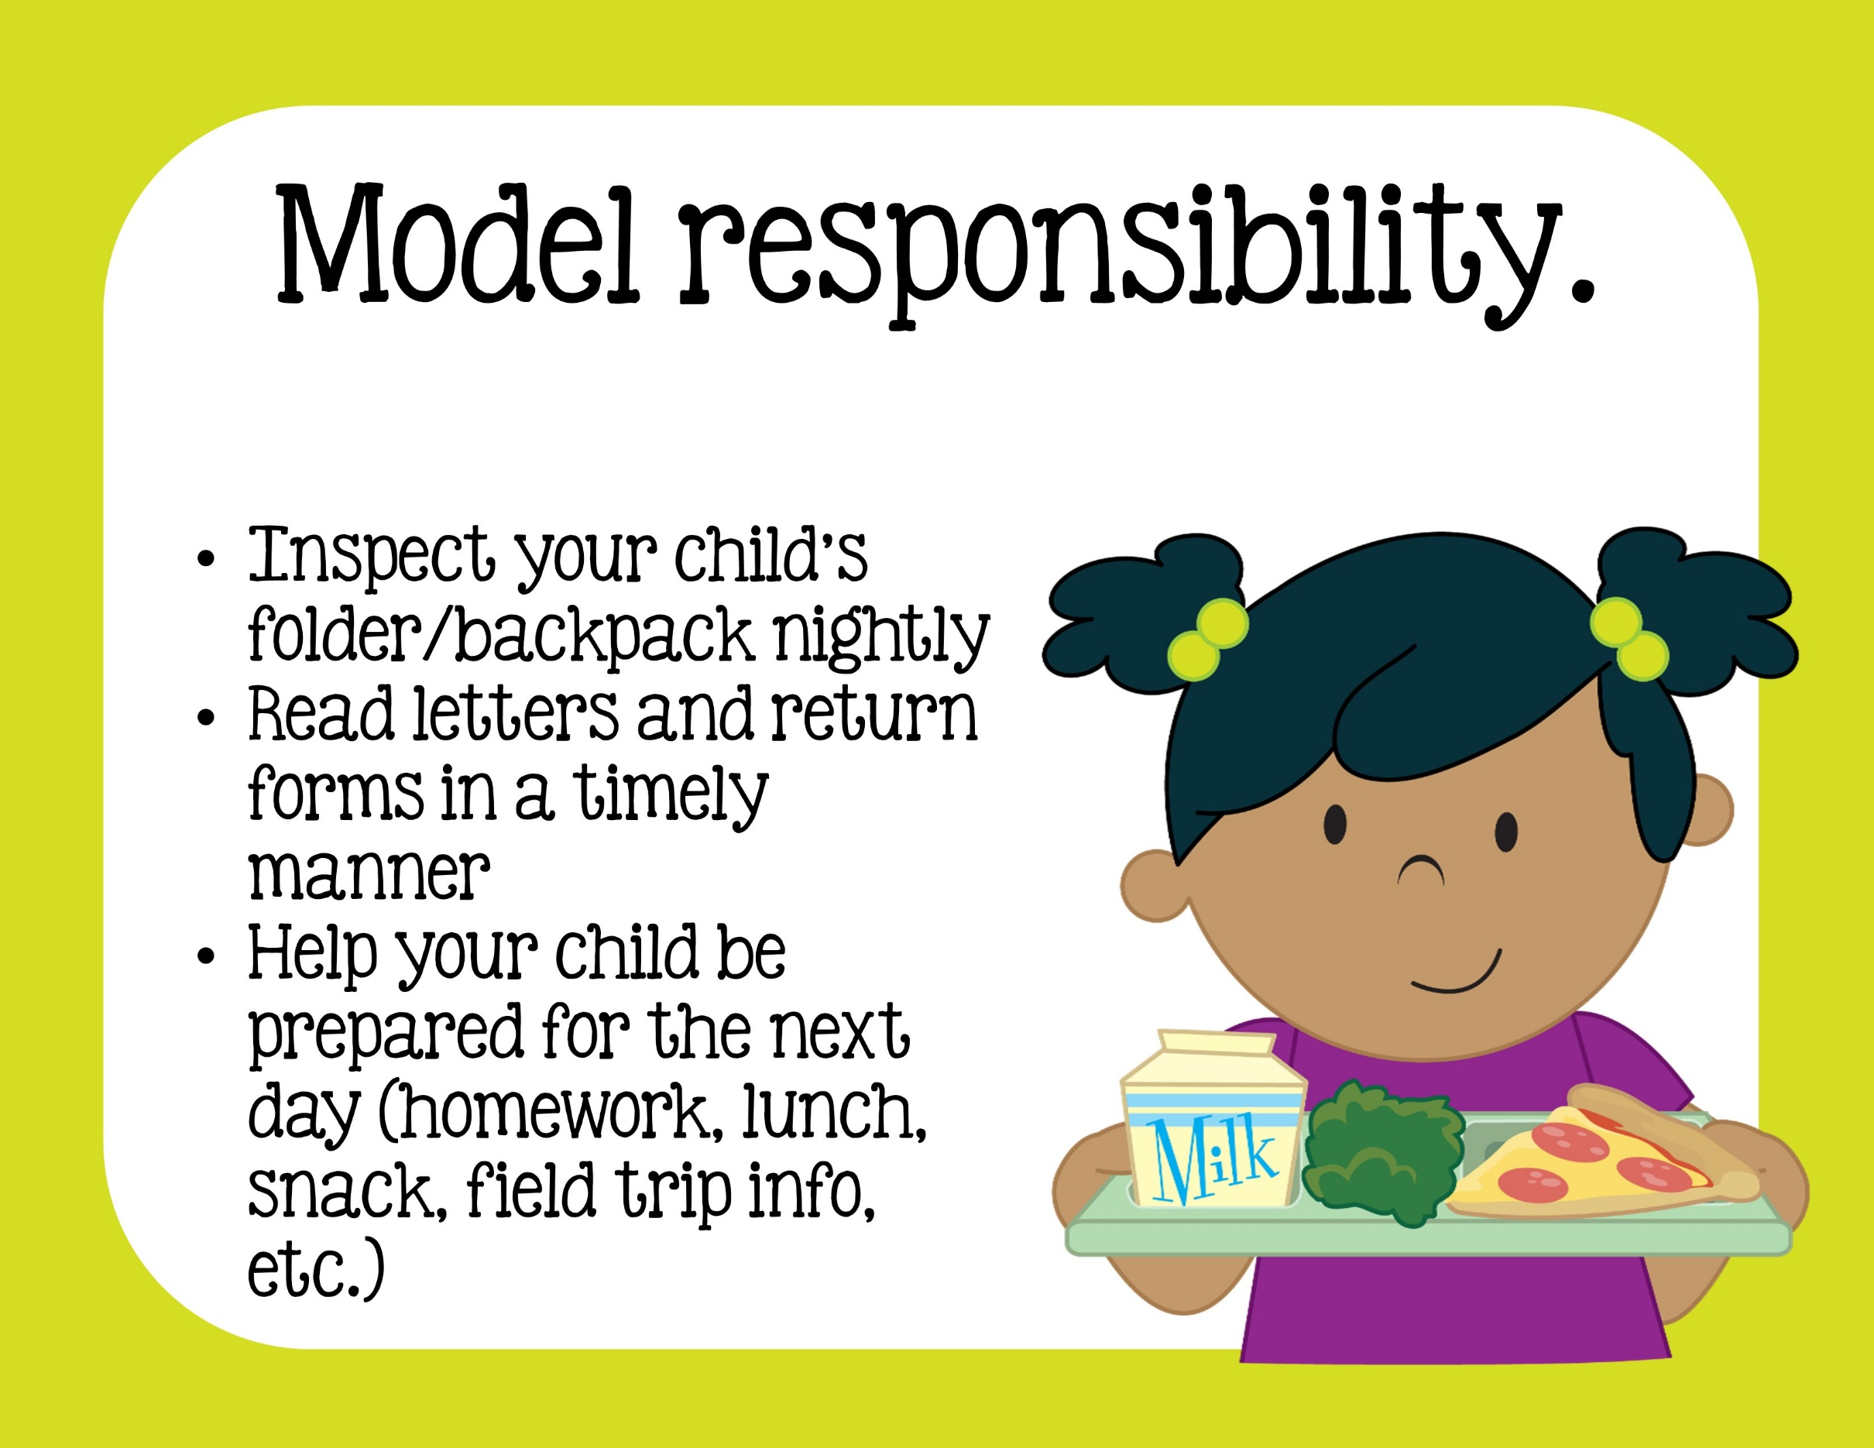

Slide 6
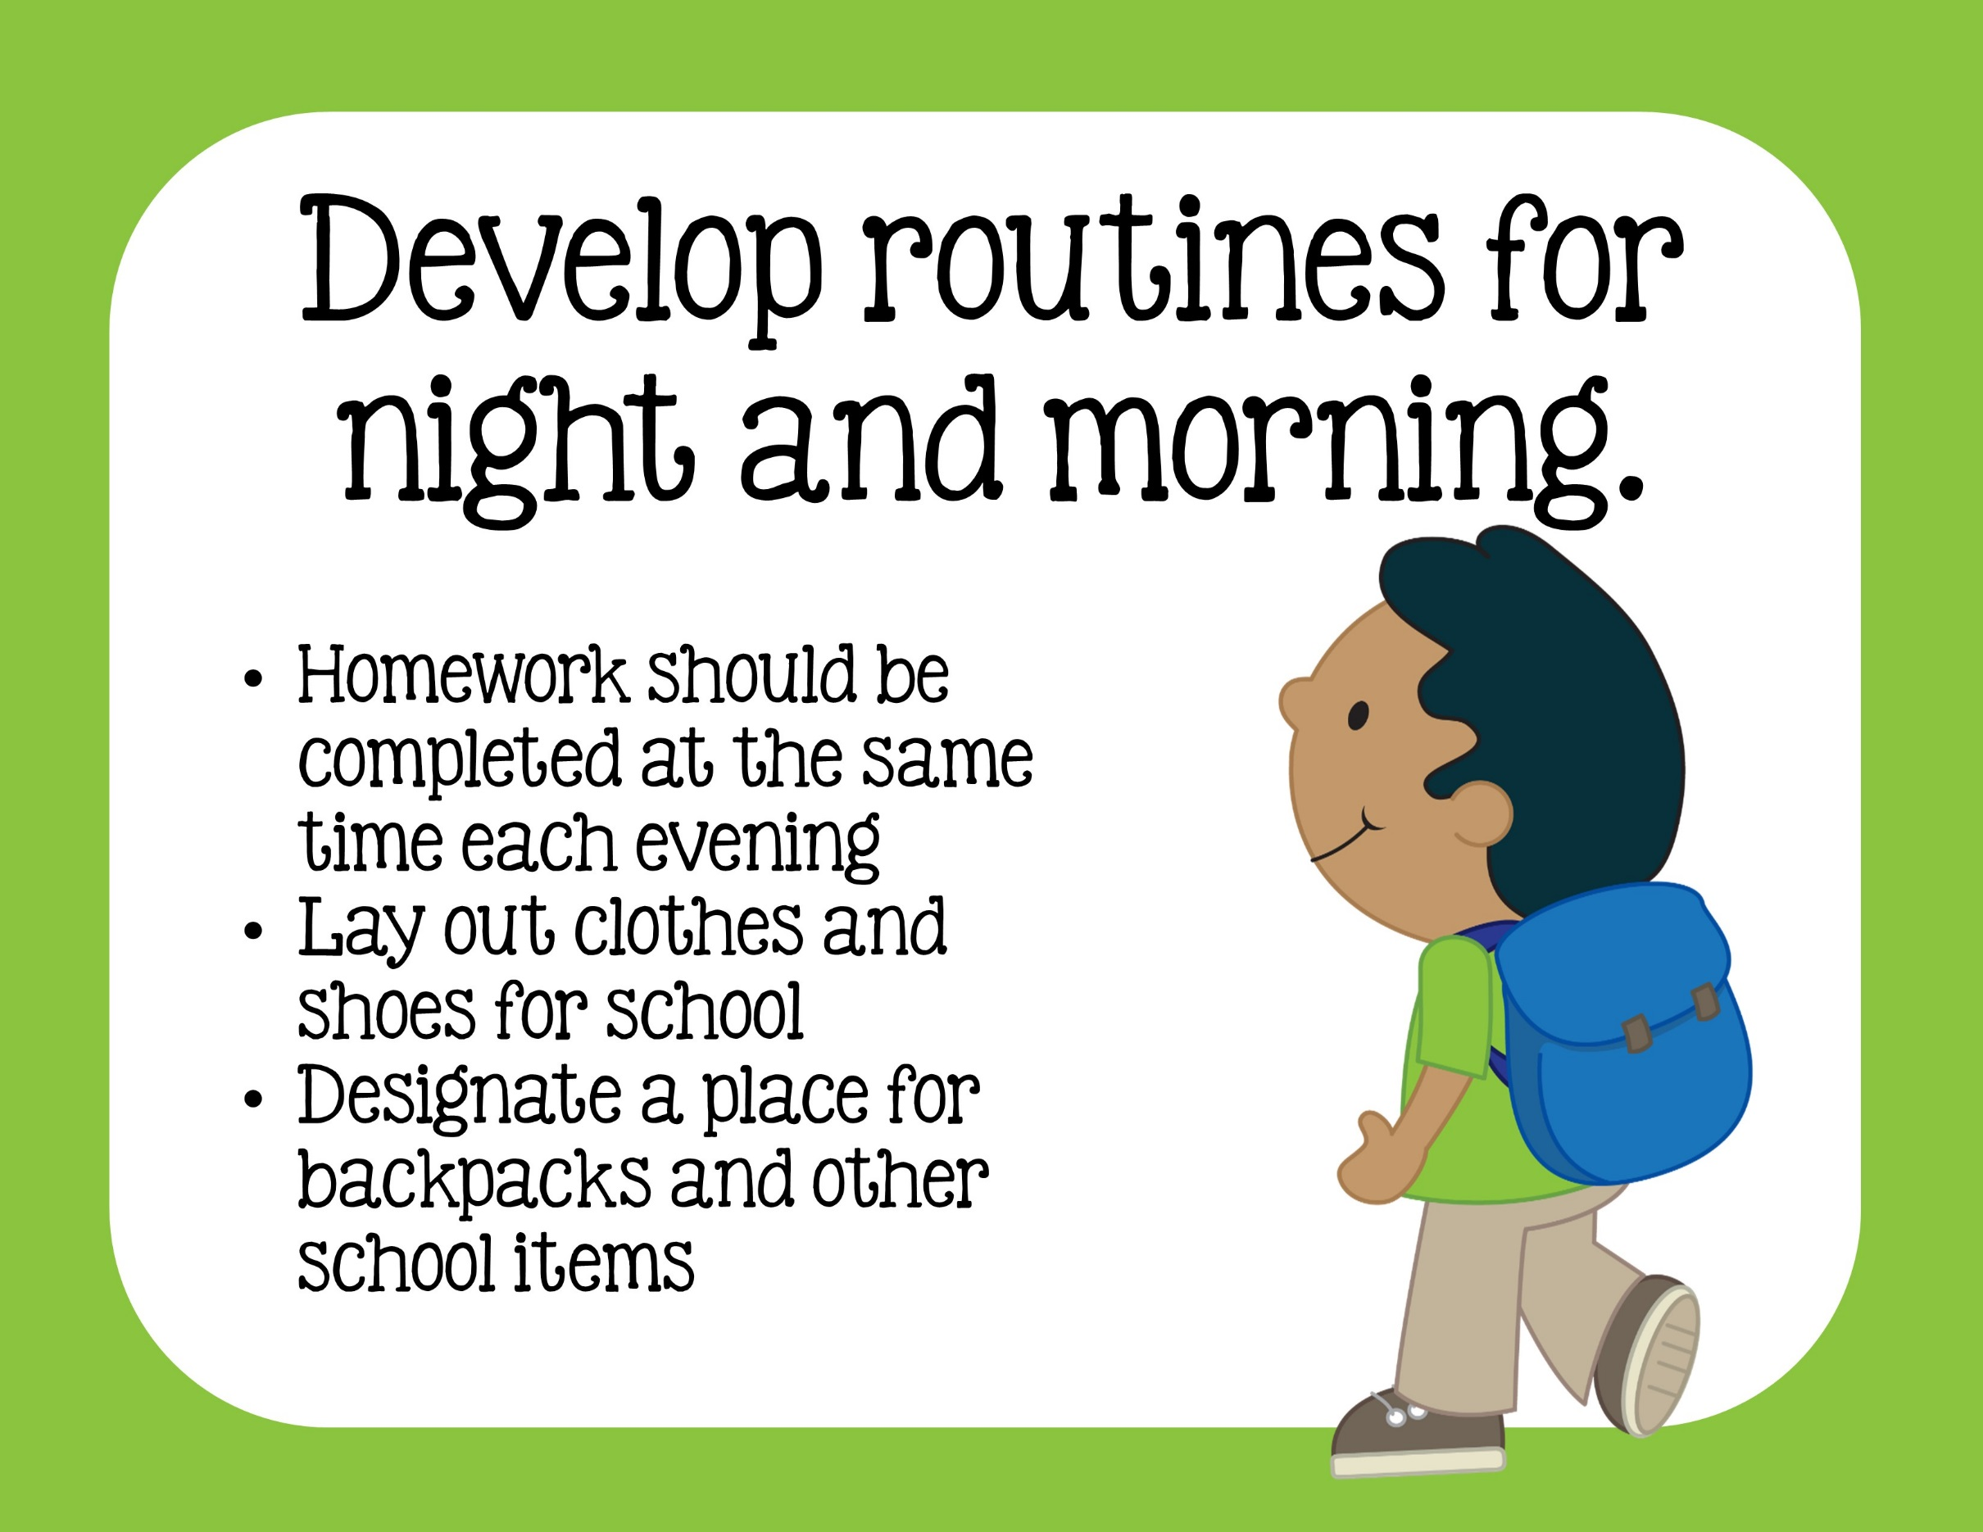

Slide 7
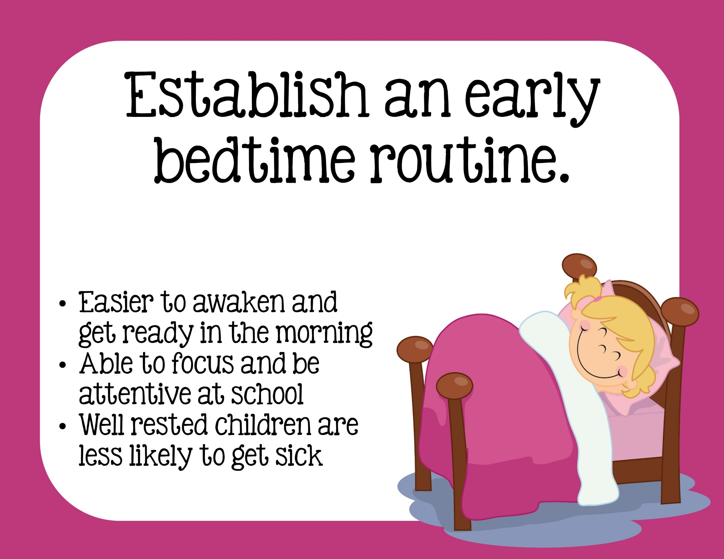

Slide 8
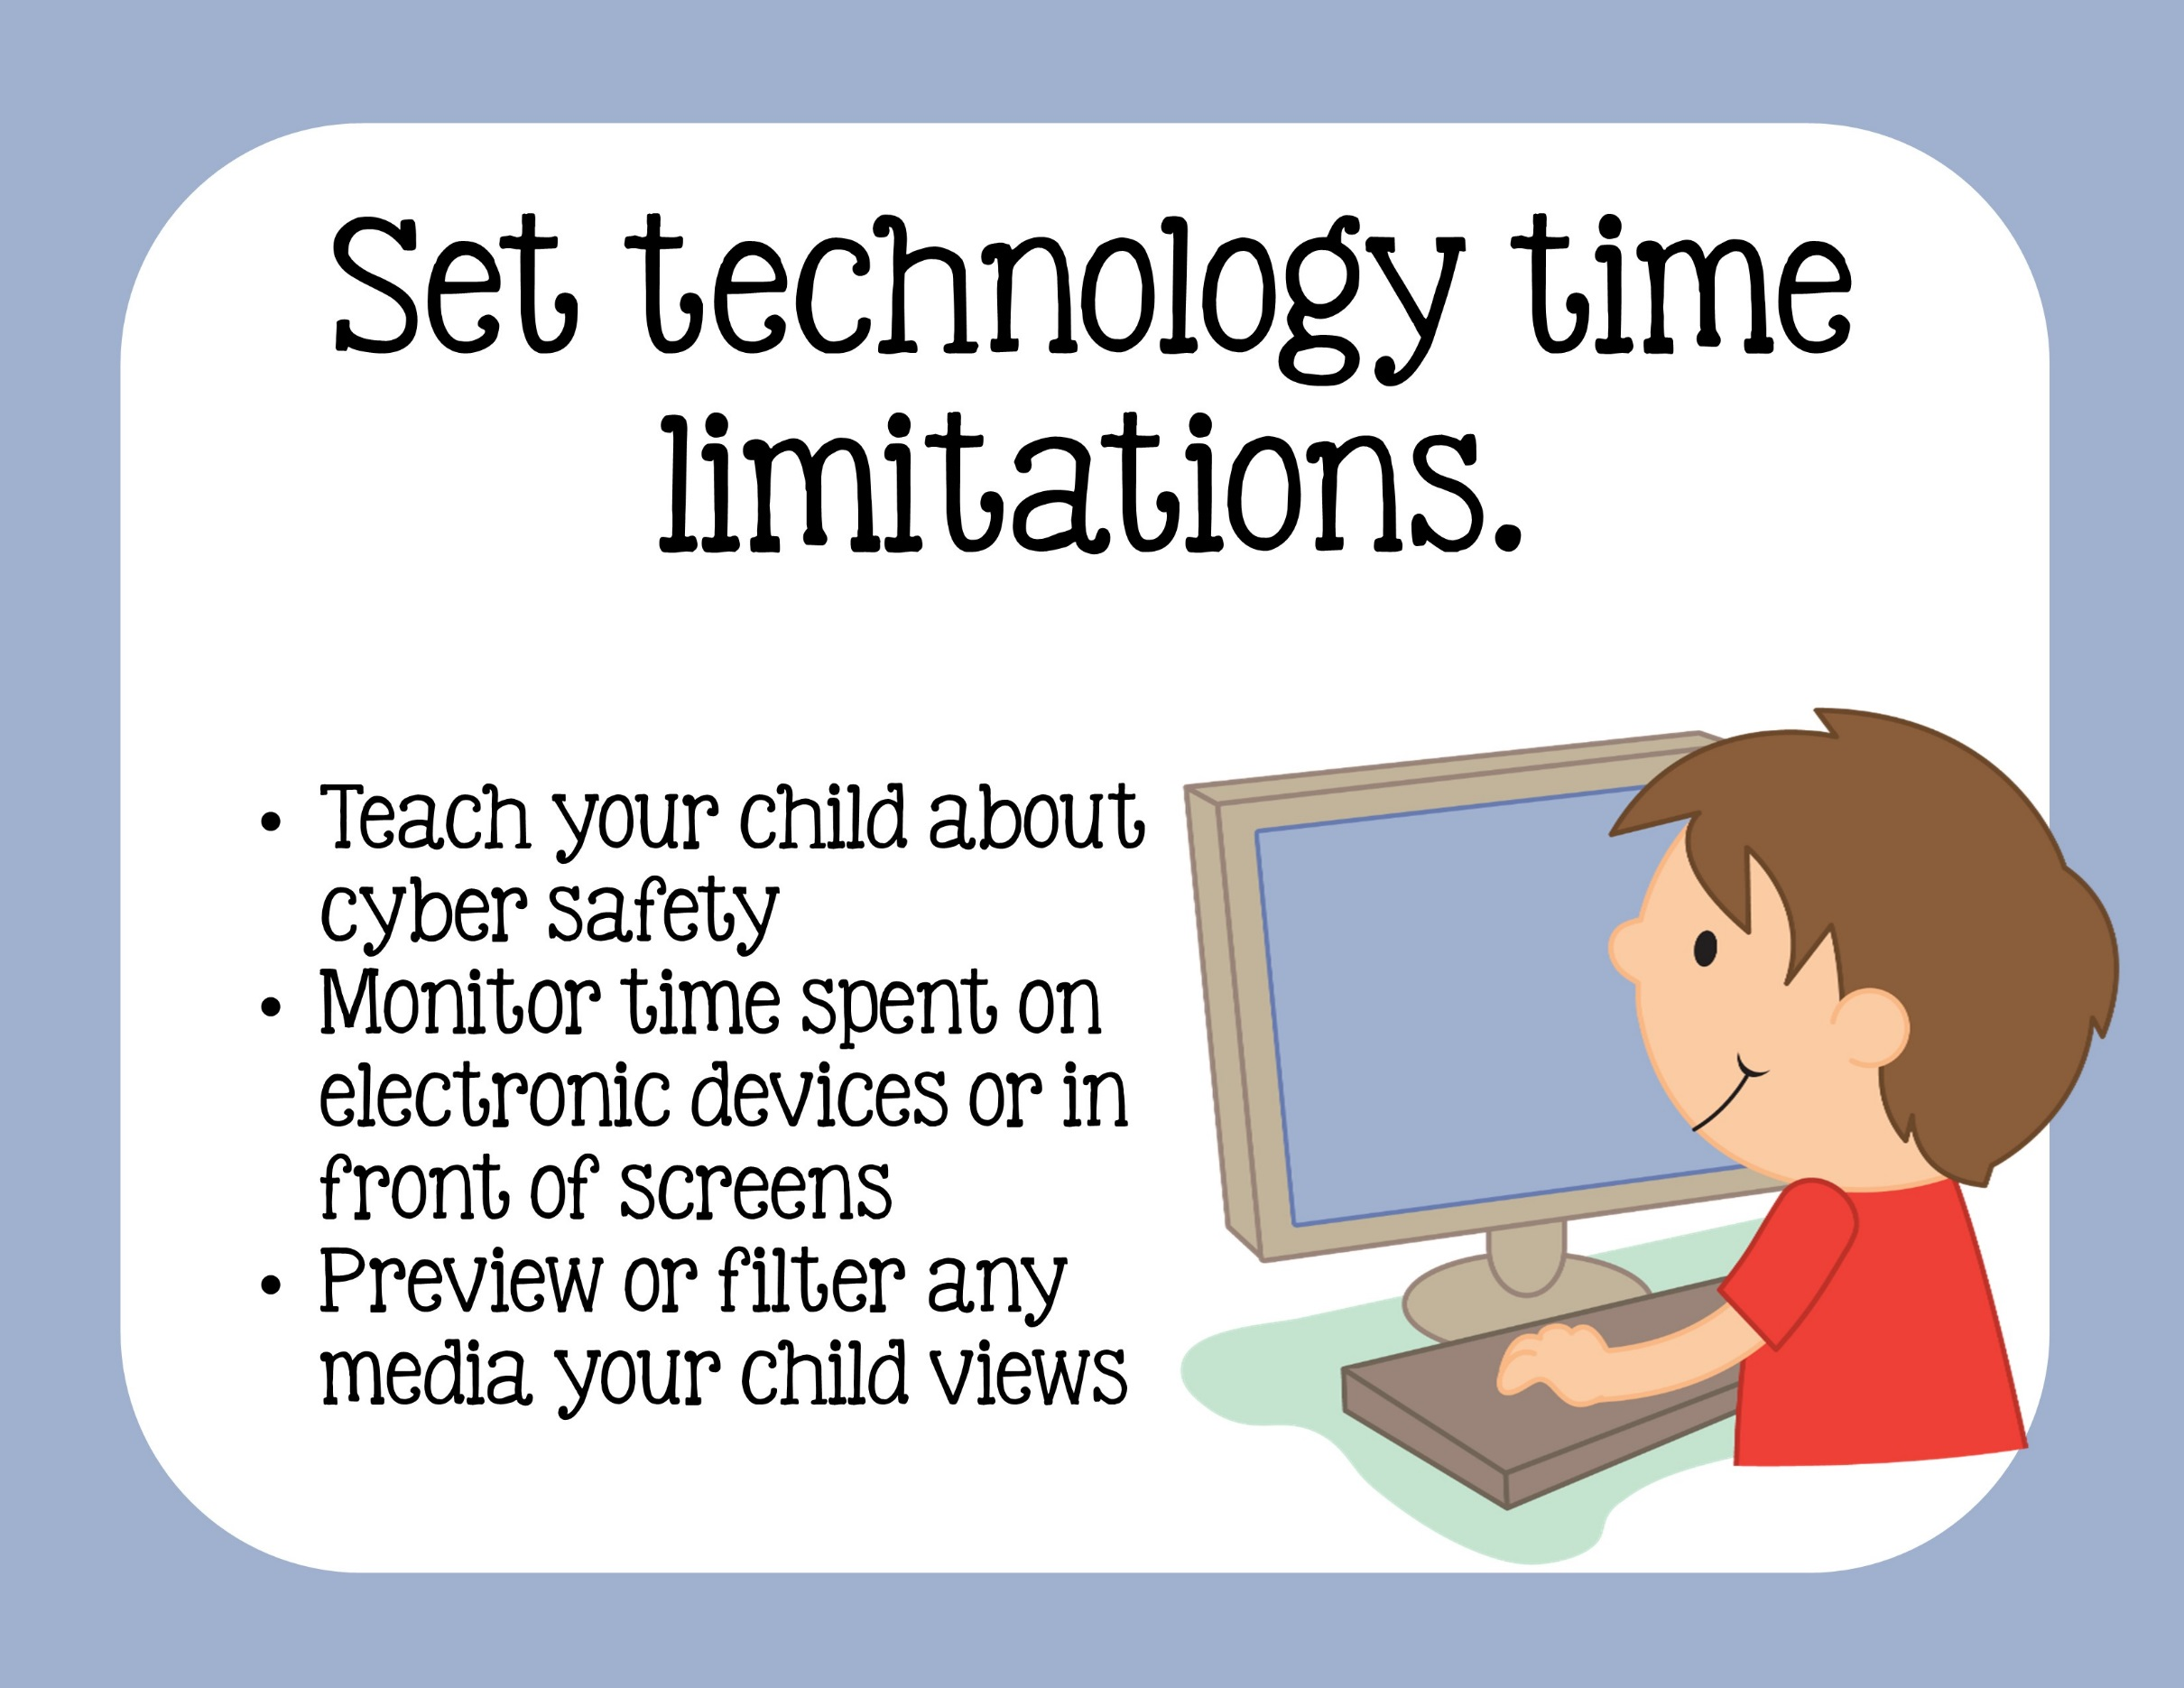

Slide 9


Slide 10


Slide 11


Slide 12



Thank you for downloading this freebie from
I appreciate your interest and hope you will check out more of my ideas and resources at my TPT store:
2nd Grade Snickerdoodles.
You can follow my blog at
http://2ndgradesnickerdoodles.blogspot.com/
Please email me if you have questions or concerns.
2ndgradesnickerdoodles@gmail.com
You can follow me on Pinterest at:
http://pinterest.com/sjpmholley/
Credits:
This item is the creative property of Jenn at 2nd Grade Snickerdoodles.
It is for individual classroom use and is not to be resold or redistributed.
This product is copyright protected by the Digital Millennium Act.
© 2nd grade Snickerdoodles. LLC 2014

