Slide 1
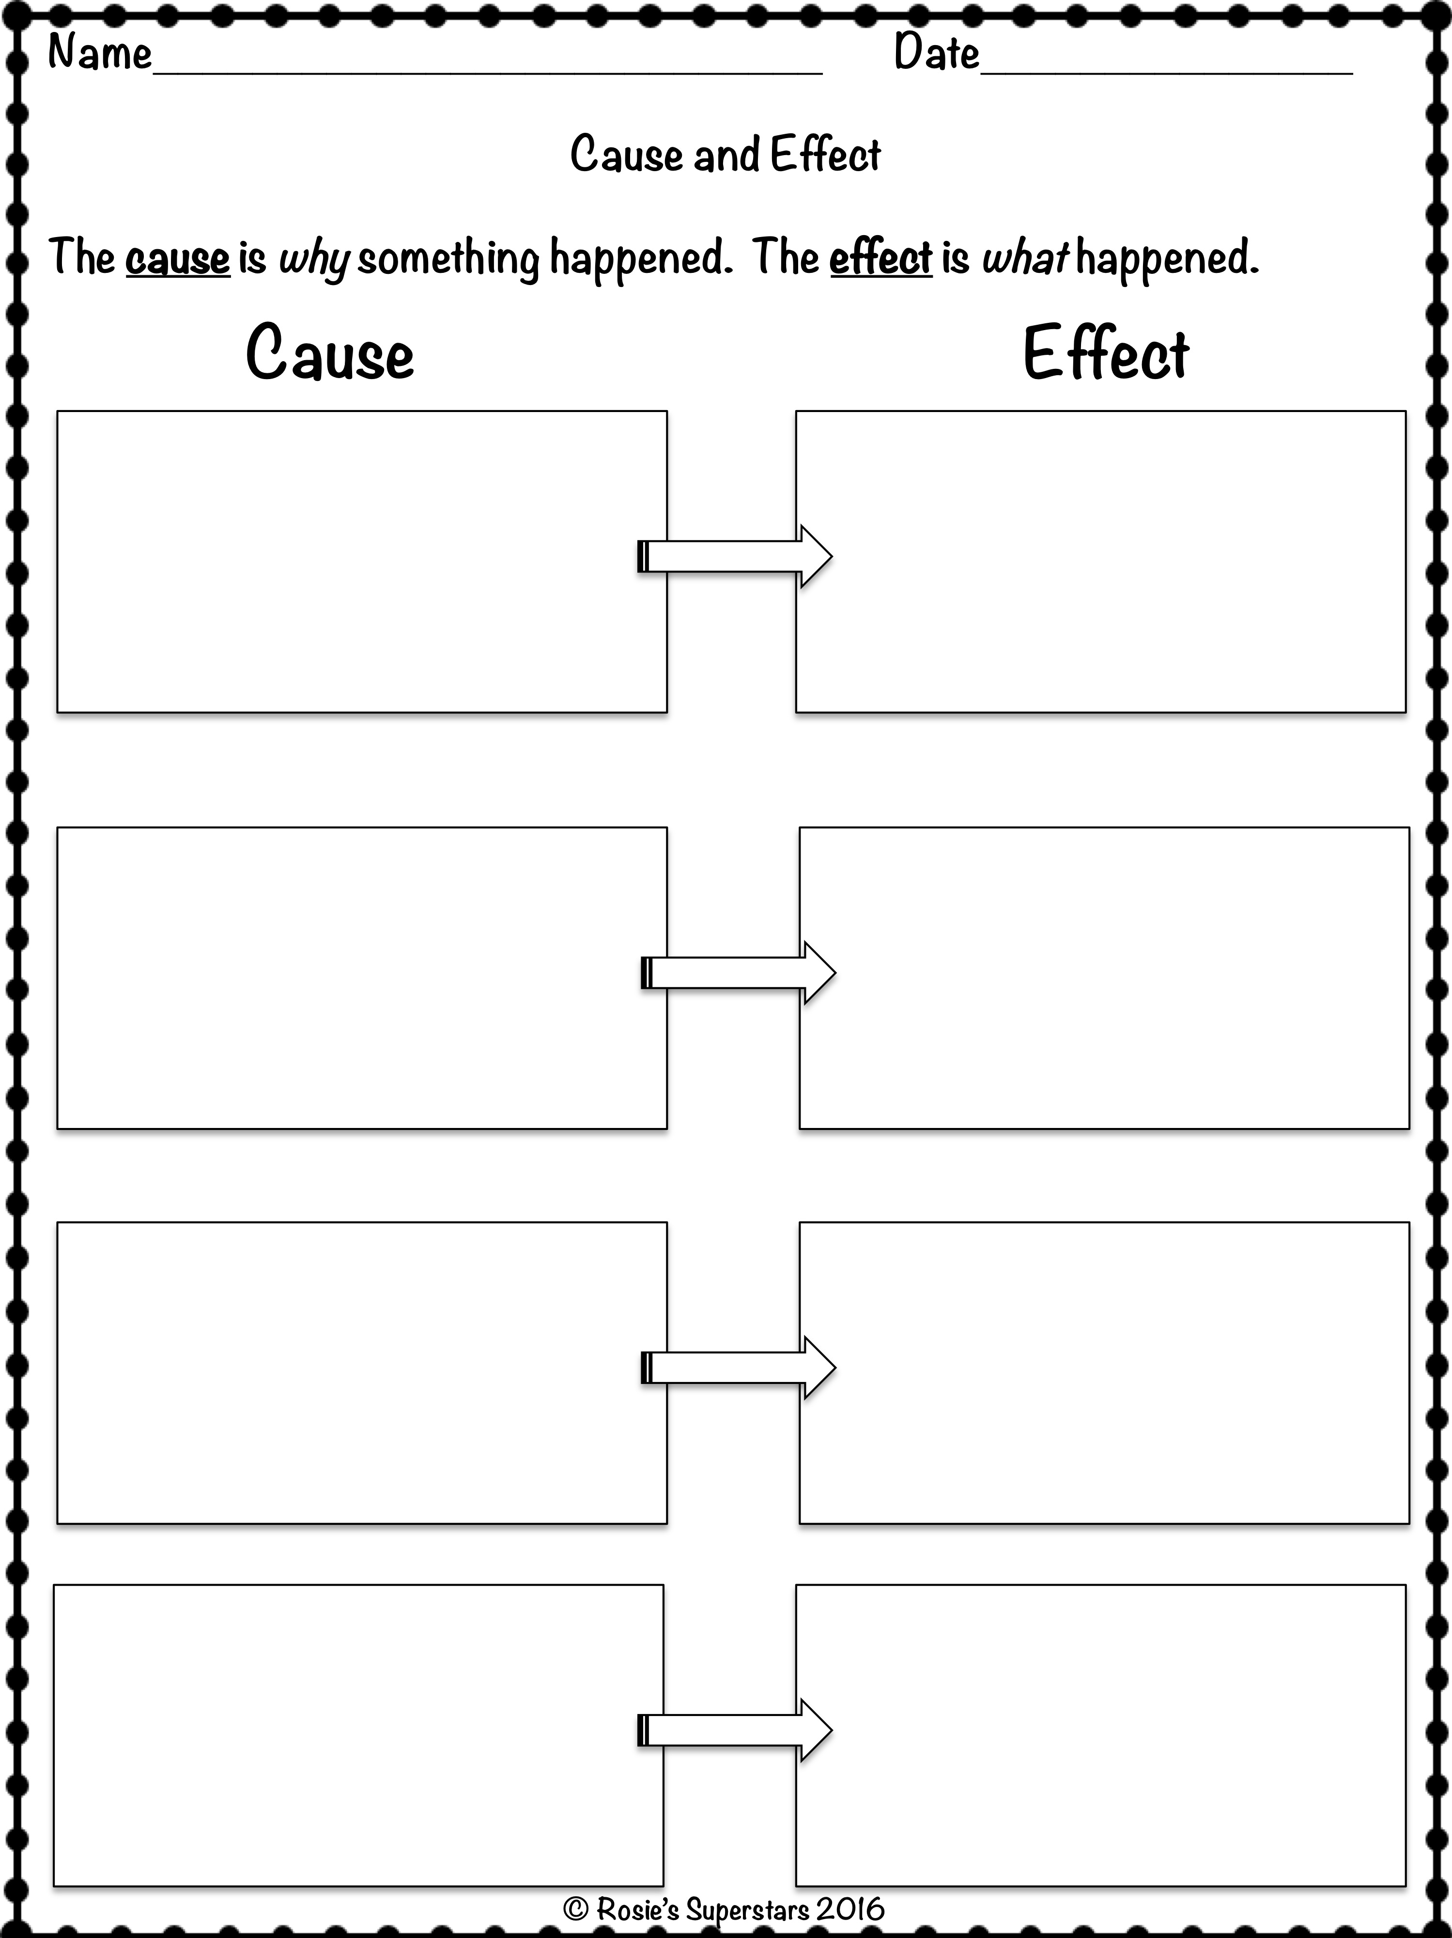
Why did the Mallard Family migrate?
What happened because of the cause?
Text
Text
Text
Text
Text
Text

Slide 2
Adapted by Maestra Casiano for
Family Fun Activity on Animal Migration

Slide 3
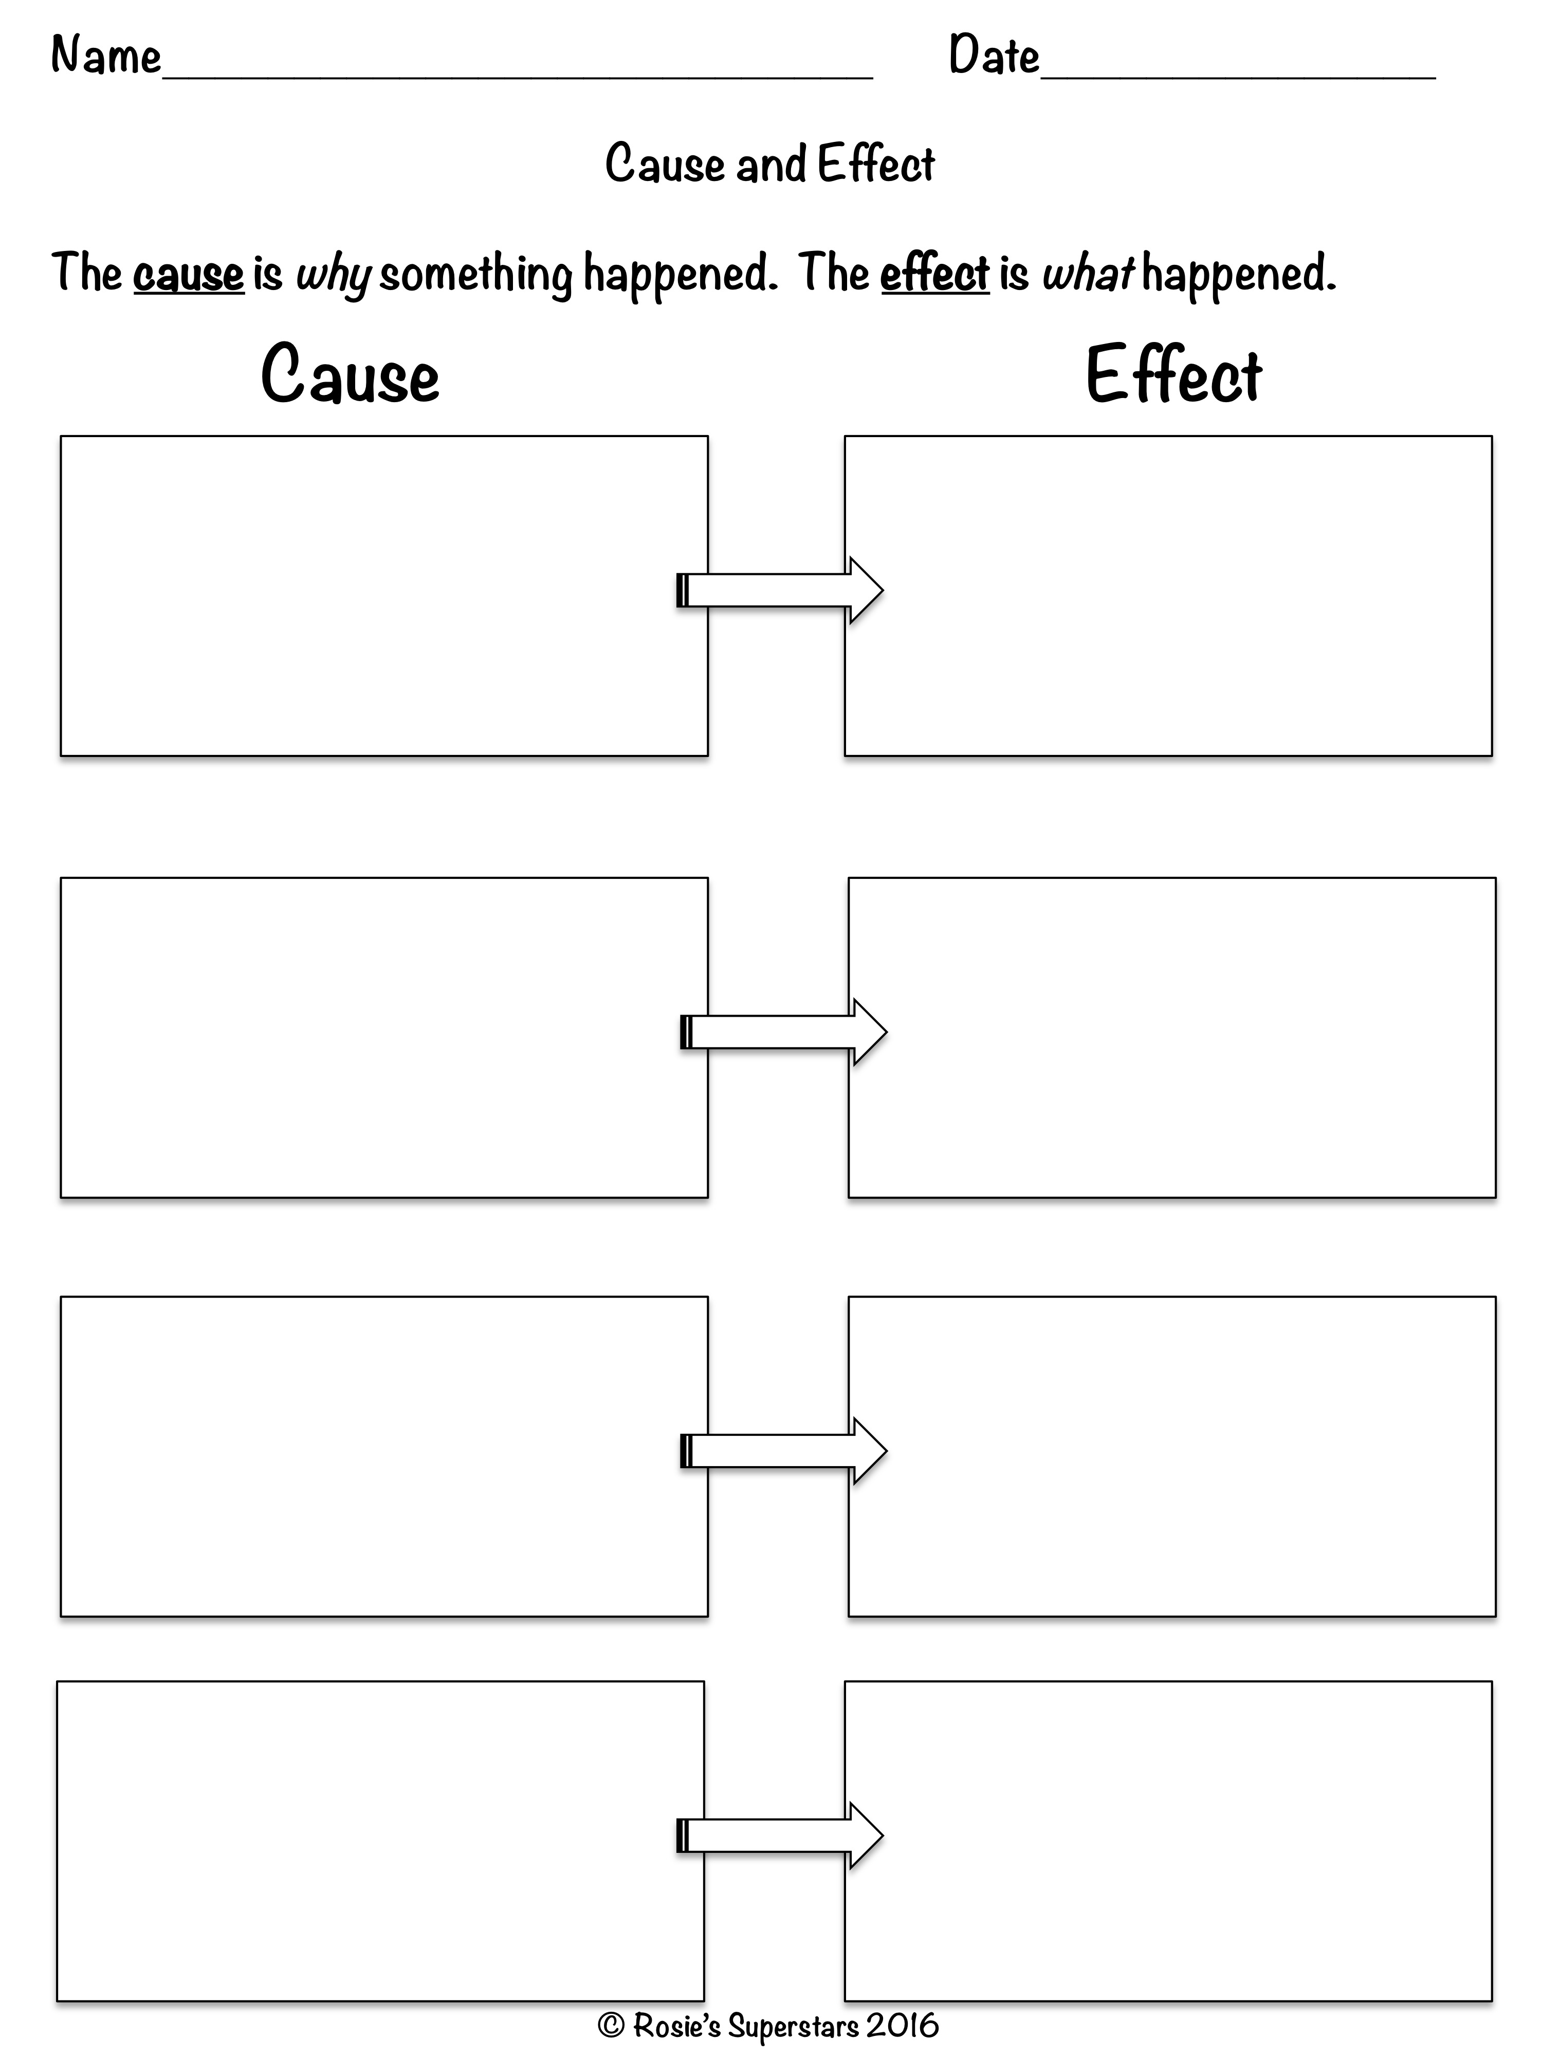

Slide 4
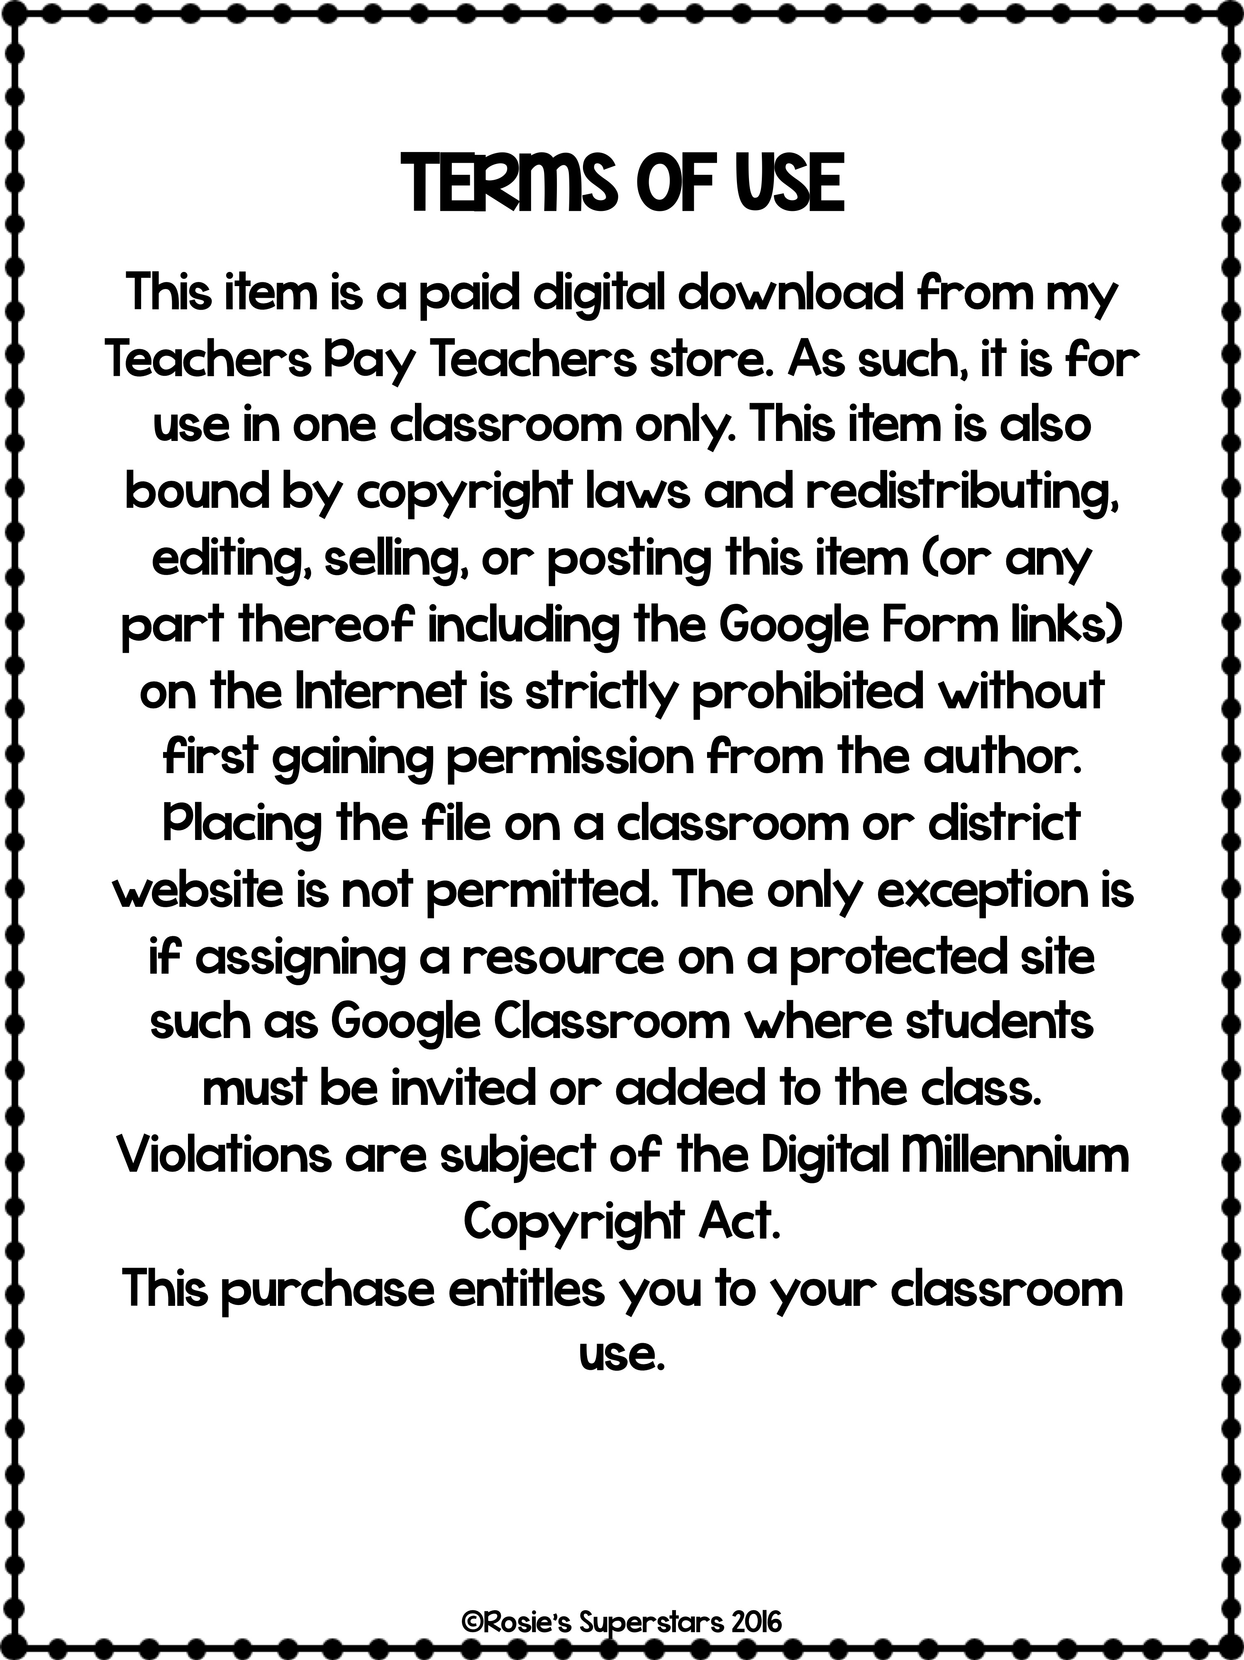

Slide 5
Thank you for downloading this resource.
Check out more of my resources at
https://www.teacherspayteachers.com/Store/Rosies-Superstars
Follow my store for new and free products. New products are 50% off for the first 48 hours.
Please e-mail me at rosiessuperstars@gmail.com for any suggestions.
Graphics by these fabulous artists:

