Slide 1
Passover STEAM
STUMBLERS

Slide 2
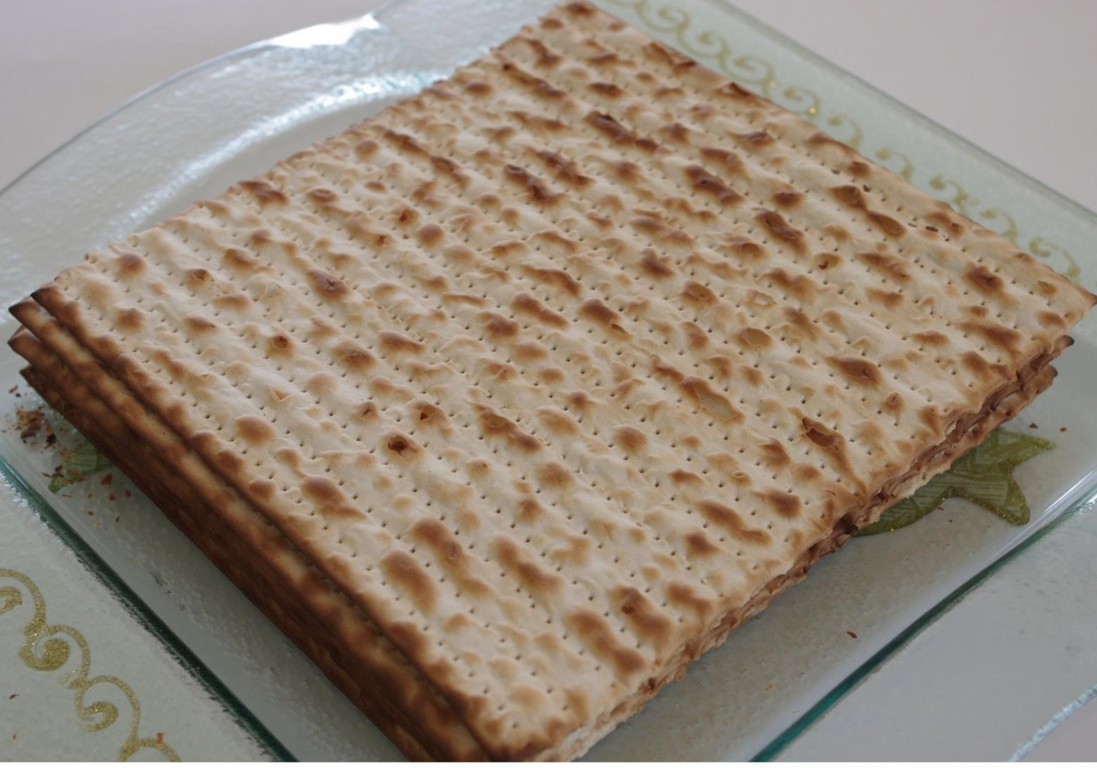
Puzzle #1
18 Minute Challenge
See if you can make matzo in just 18 minutes, so that it has NO chance of fermenting. All you need are the following ingredients ready to go, a rolling pin, a fork, and a pizza stone or baking sheet. On your mark, get set, set your time for 18 minutes and GO!!!
2 cups all-purpose flour
1 teaspoon kosher salt
1 tablespoon olive oil
3/4 cup water
Preheat oven to 500°F with baking Steel or pizza Stone on the middle rack. Mix all ingredients together until a ball forms. Divide it into 6 smaller balls and roll each one out. Pierce it with a fork and bake for 2 minutes, turn it over, and bake for another 1-2 minutes.

Slide 3
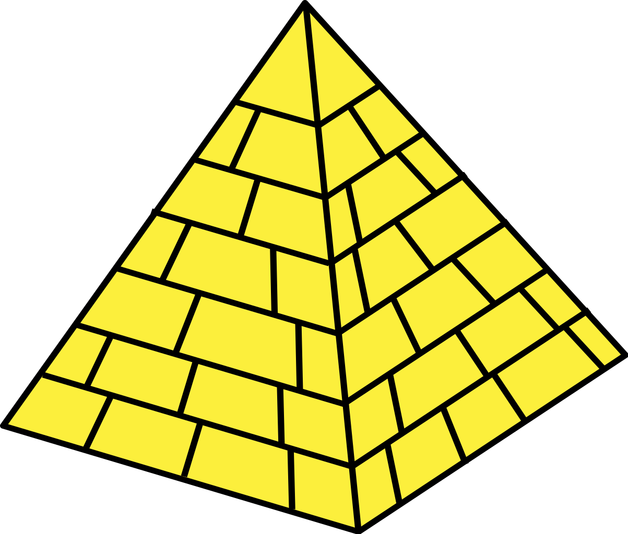
Puzzle #2
Pyramid Power
Jews were slaves in Egypt and built pyramids for the Egyptians. Build your own mini, edible triangular pyramid using Passover foods, such as matzo, marshmallows, vegetables, fruit, etc. Use your imagination and make it yummy to eat!

Slide 4
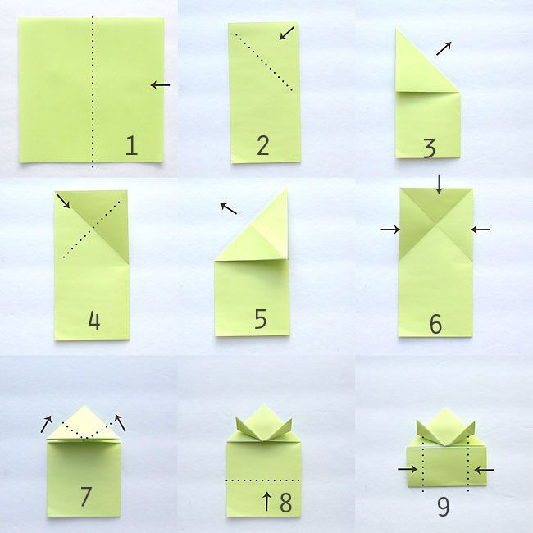
Puzzle #3
Frog Jump
Frogs were one of the ten plagues. how far you can get your frog to jump?
First, make an origami frog.
To make the frog jump,
simply push down on its
back legs and release!
It will flip and jump!
How can you adjust your frog
to make it jump further?

Slide 5
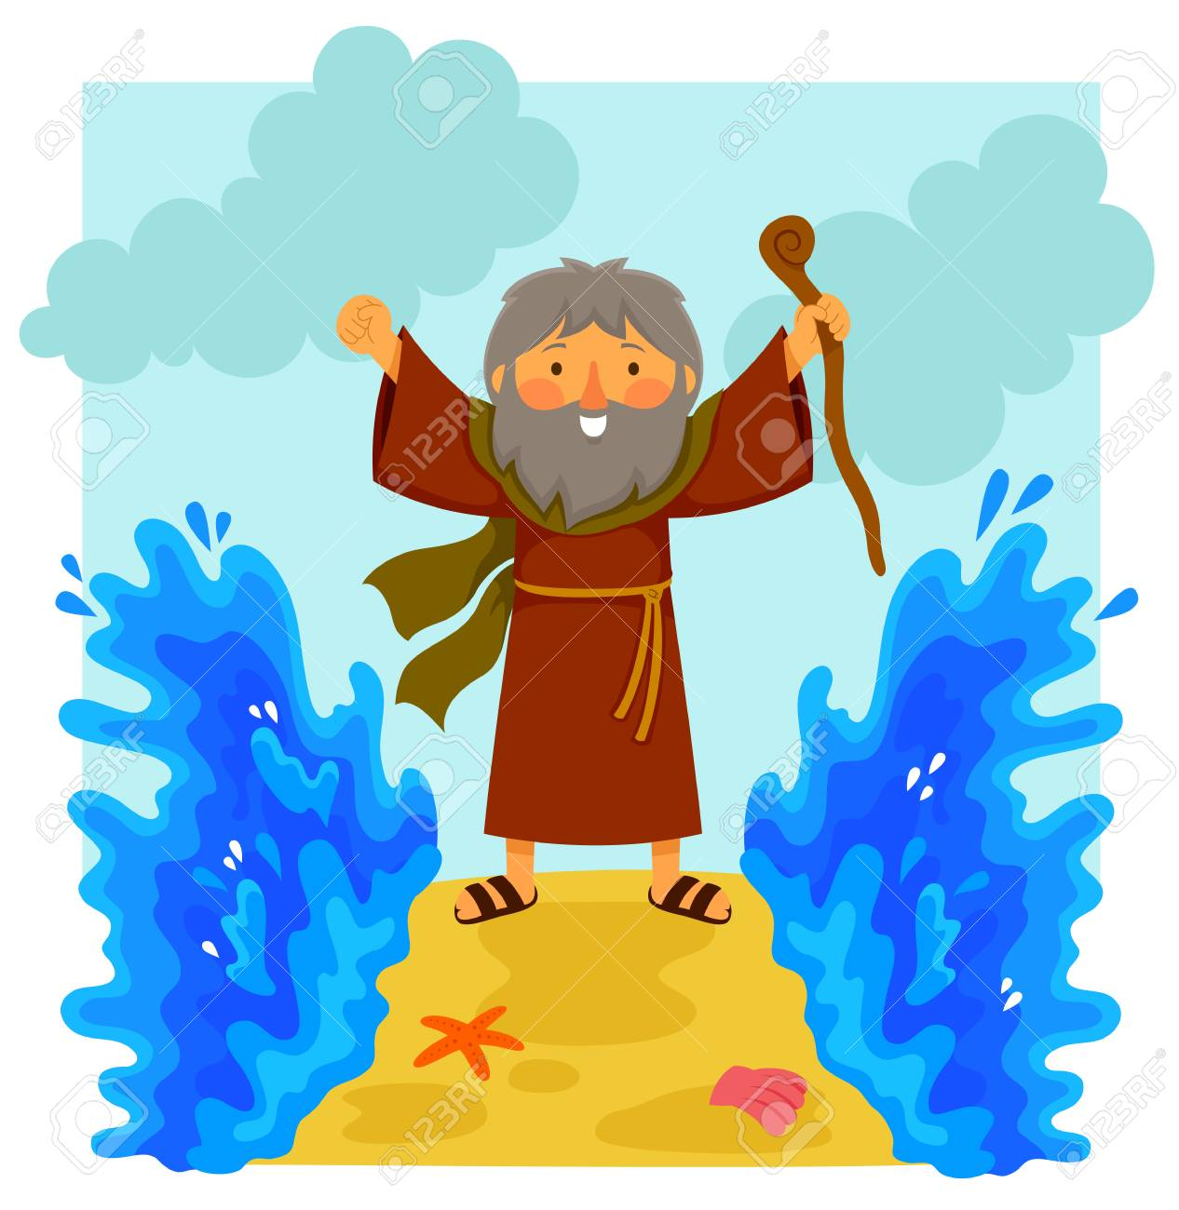
Puzzle #4
Parting the Sea
Moses held up his staff and God parted the Red Sea so the Jews could leave Egypt.
How can YOU make the Red Sea part ? Using red pepper, soap, and a dish of water and a toy “Moses”, try parting the “sea.”

